Slide 1
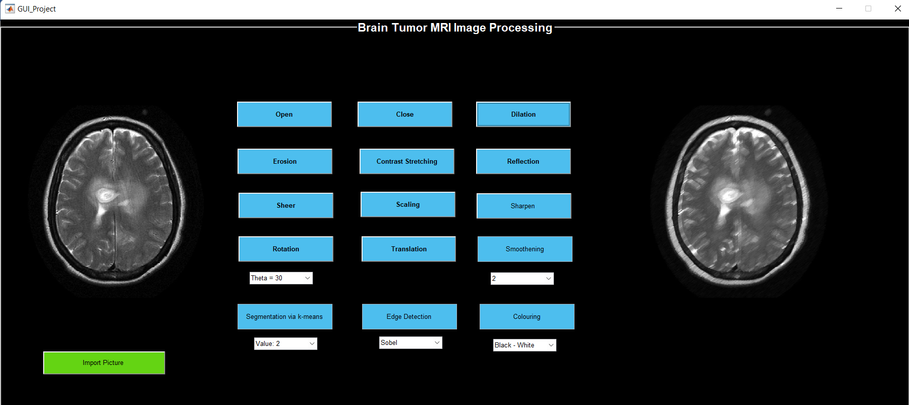
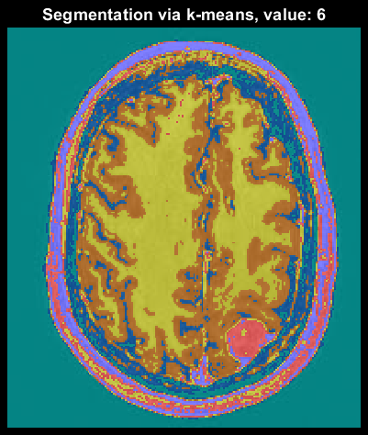
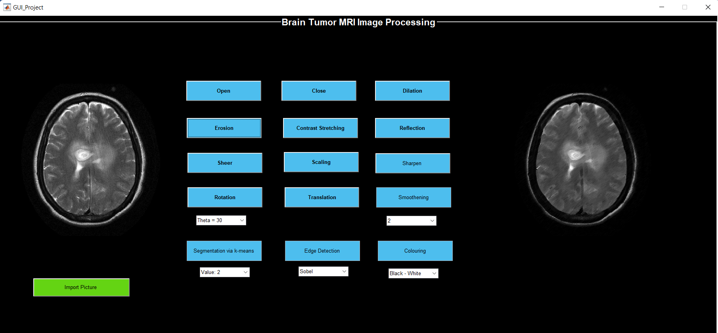
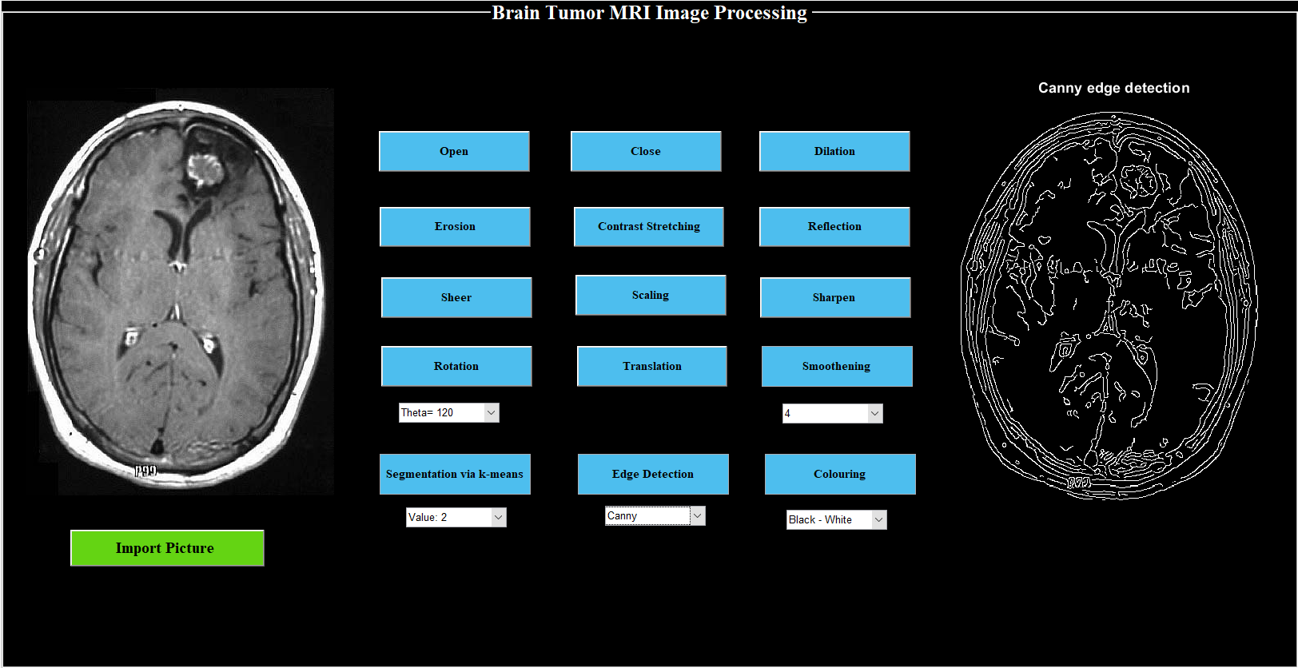
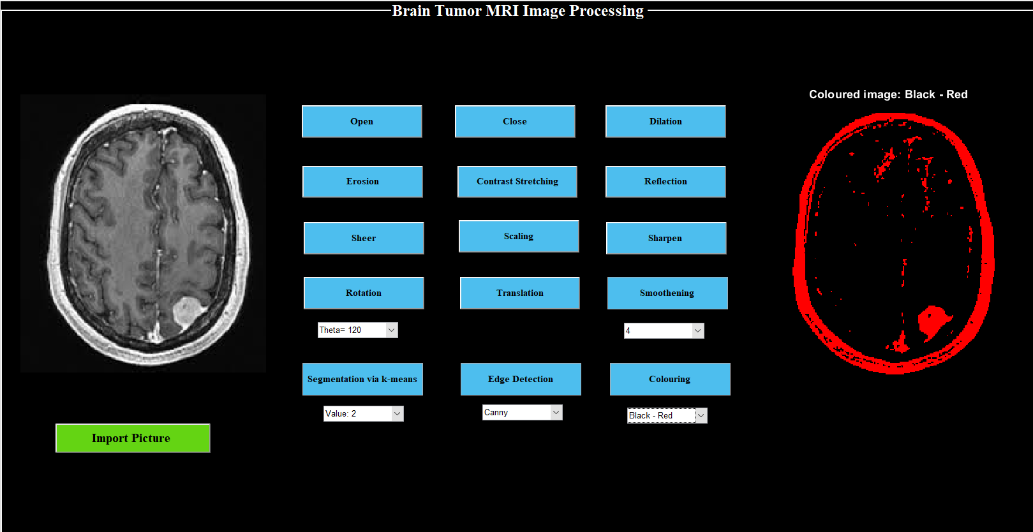
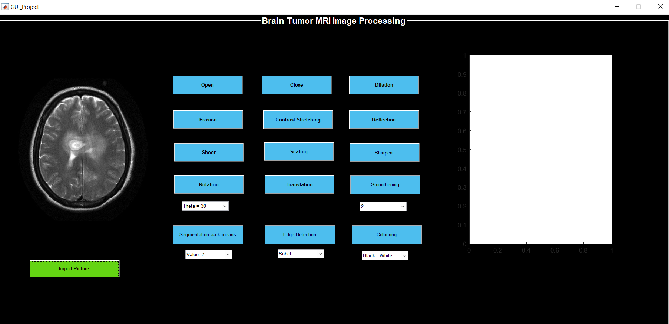
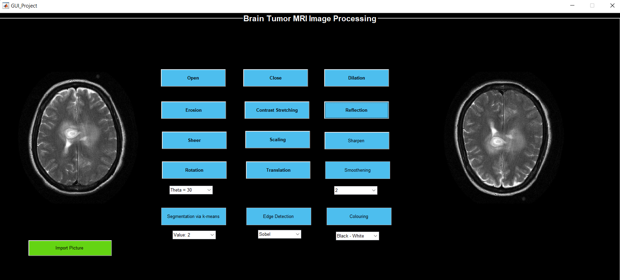
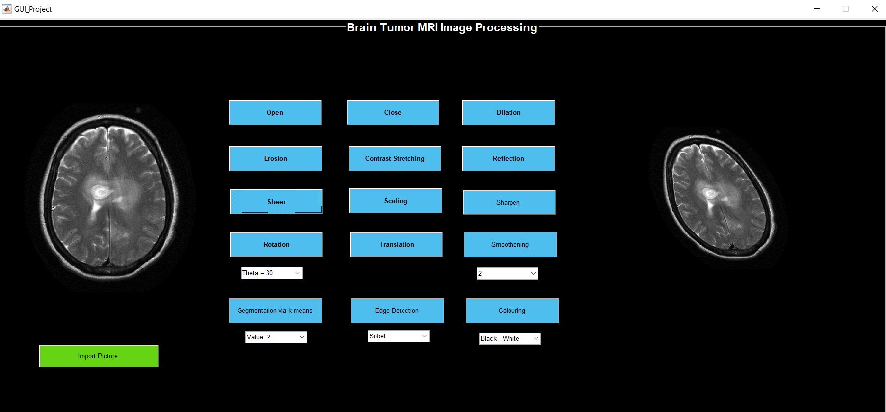

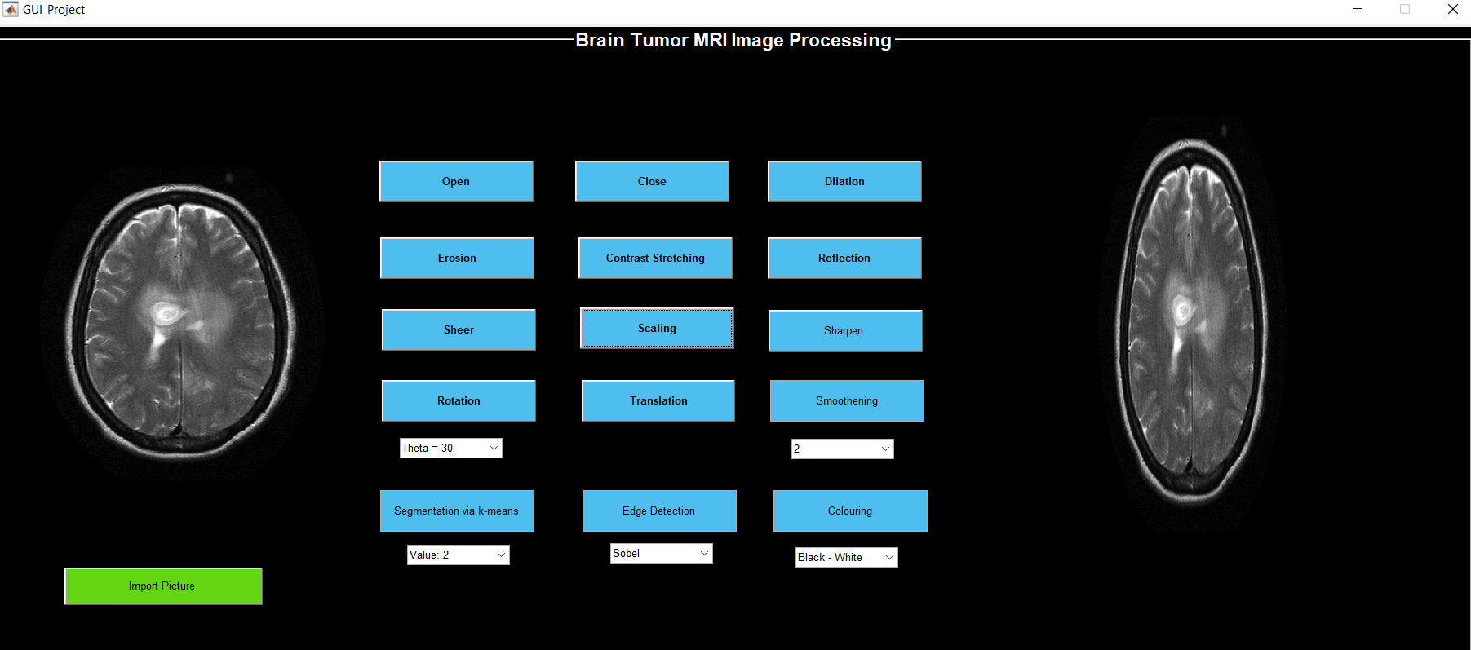
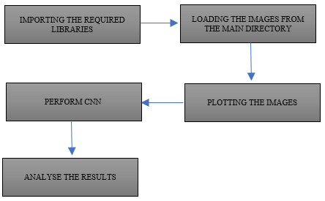
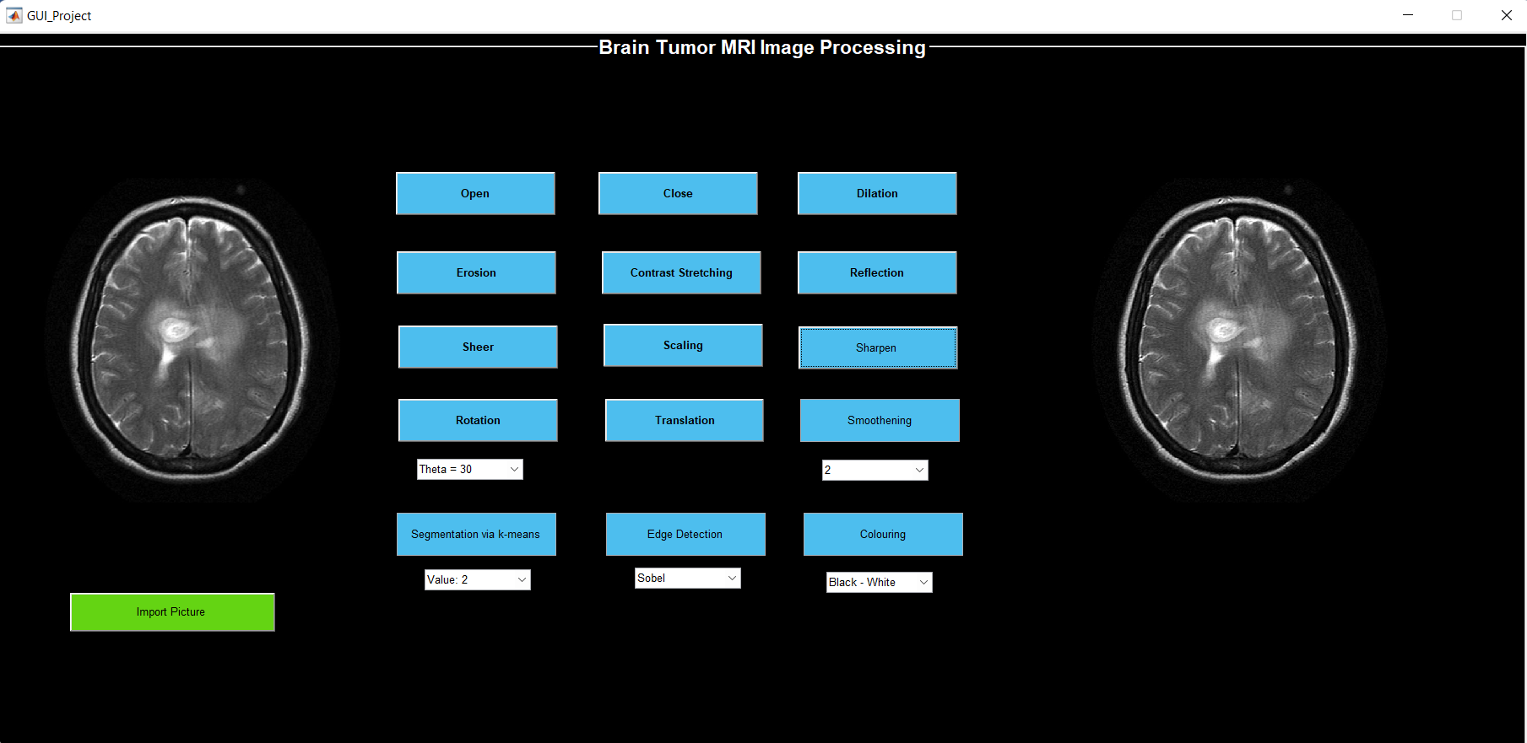
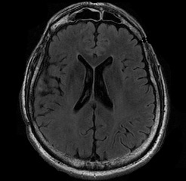
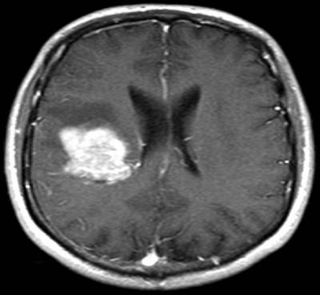

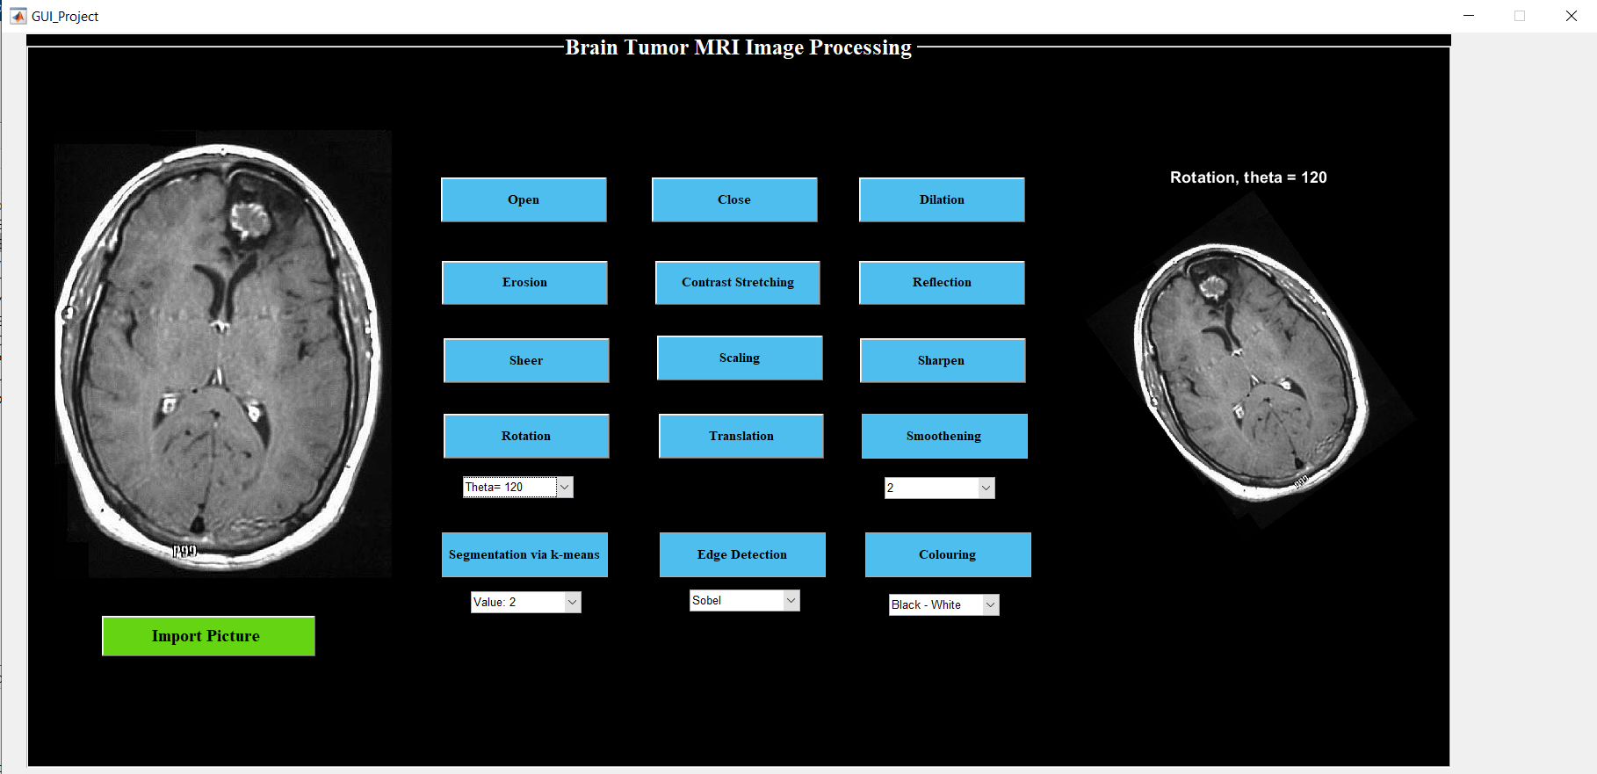
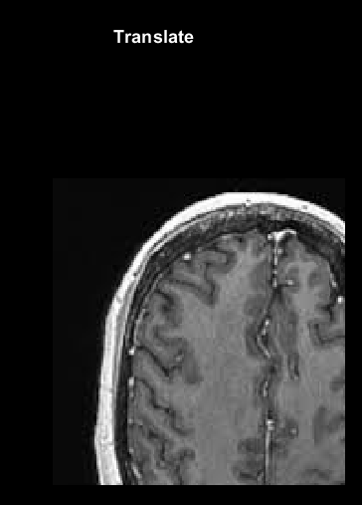
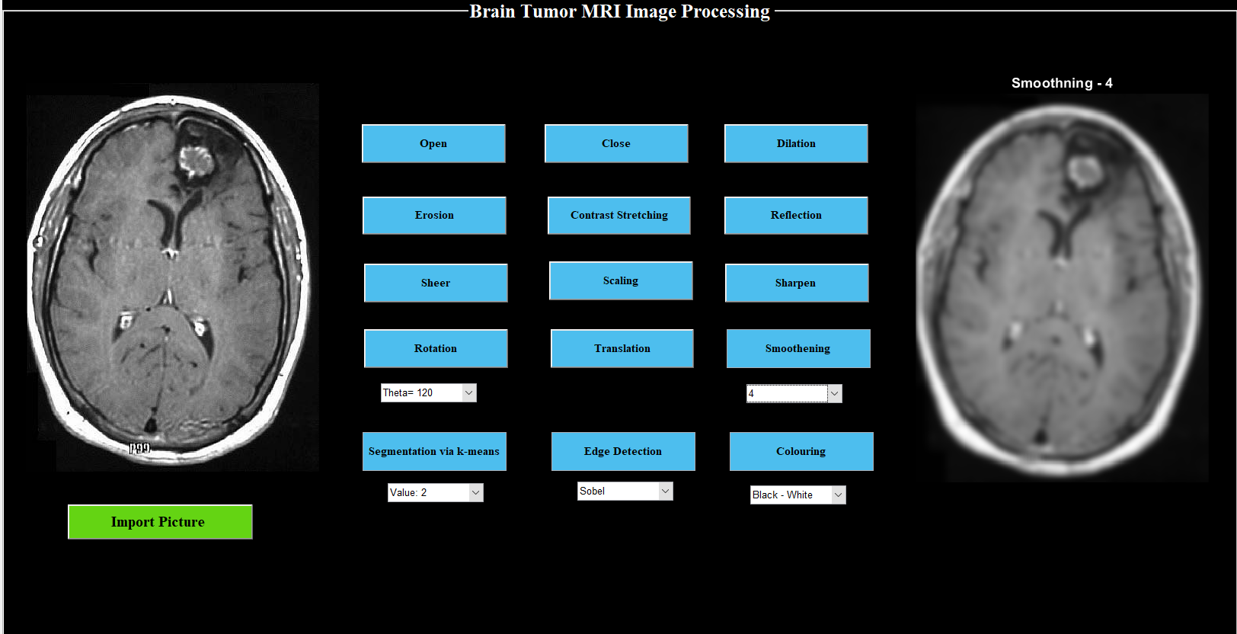

Brain Tumor Prediction and Image Processing
Nandhitha Ravishankar, P Sadhana
nandhitharavishankar@gmail.com, psadhana2002@gmail.com
ABSTRACT
IMAGE ANALYSIS
3. Dilation adds pixels to the boundaries of objects in an image. The number of pixels added or removed from the objects in an image depends on the size and shape of the structuring element used to process the image.
CONCLUSION AND FUTURE WORK
Early diagnosis of brain tumors plays an important role in a patient’s treatment and makes it easy to save his/her life. The conventional method of manually detecting brain tumors from brain magnetic resonance imaging (MRI) scans can be problematic and erroneous. This paper presents an automatic brain tumor detection using CNN and also have performed Image Processing to analyze and understand the images. An accuracy of 61.25% was obtained. A GUI was created on MATLAB to visualize the analysis outputs for the images.
Image Analysis has been done using various techniques on MATLAB. A graphic user interface (GUI) has been created to visualise the outputs. Operations such as open, close, dilate, erode, contract stretching, reflection, sheer, scaling, sharpening, rotation, translation, smoothening, segmentation, edge detection and colouring have been performed.
Image is imported on browsing the required image through the dataset and those operations are performed on that image.
13. Often based on the properties of pictures pixels, image segmentation is a widely used method in image processing and analysis to divide an image into various parts or areas.
With the advancement in technology, detection severe problems such as brain tumor has become easier. Using various deep learning techniques will give a higher rate of accuracy in the prediction and thus making treatment much easier. The model designed in this project gives an accuracy of 61.26% which can be also improved using other deep learning techniques. Moreover, analyzing the brain MRI images, it helps to bring a better understanding of the images
4. Erosion shrinks the image pixels. Erosion removes pixels on object boundaries.
14. Edge detection is a method of image processing that locates the edges of objects in pictures. It operates by looking for changes in brightness.
5. Contrast stretching is a straightforward image enhancement technique that aims to boost contrast by "extending" the intensity values in a picture to cover a specified range of values, or the entire set of pixel values that the target image type permits.
15. Adding colour, to a black and white image has been done
BRAIN TUMOR DETECTION
6. The reflection operator geometrically repositions image elements, or pixel values, in such a way that they are reflected about a user-specified image axis and placed in a new position in a matching output image.
A deep learning network architecture that learns directly from data is a convolutional neural network (CNN or ConvNet).
CNNs are very helpful for recognising objects, classes, and categories in photos by looking for patterns in the images. They can be quite useful for categorising signal, time-series, and audio data.
REFERENCES
DATASET
[1] N. M. Dipu, S. A. Shohan and K. M. A. Salam, "Deep Learning Based Brain Tumor Detection and Classification," 2021 International Conference on Intelligent Technologies (CONIT), 2021, pp. 1-6, doi: 10.1109/CONIT51480.2021.9498384.
[2] S. Handore and D. Kokare, "Performance analysis of various methods of tumour detection," 2015 International Conference on Pervasive Computing (ICPC), 2015, pp. 1-4, doi: 10.1109/PERVASIVE.2015.7087002.
[3] Deepa and A. Singh, "Review of brain tumor detection from MRI images," 2016 3rd International Conference on Computing for Sustainable Global Development (INDIACom), 2016, pp. 3997-4000.
[4] A. Jagan, "A New Approach for Segmentation and Detection of Brain Tumor in 3D Brain MR Imaging," 2018 Second International Conference on Electronics, Communication and Aerospace Technology (ICECA), 2018, pp. 1230-1235, doi: 10.1109/ICECA.2018.8474874.
[5] E. E. Ulku and A. Y. Camurcu, "Computer aided brain tumor detection with histogram equalization and morphological image processing techniques," 2013 International Conference on Electronics, Computer and Computation (ICECCO), 2013, pp. 48-51, doi: 10.1109/ICECCO.2013.6718225.
[6] G. Raut, A. Raut, J. Bhagade, J. Bhagade and S. Gavhane, "Deep Learning Approach for Brain Tumor Detection and Segmentation," 2020 International Conference on Convergence to Digital World - Quo Vadis (ICCDW), 2020, pp. 1-5, doi: 10.1109/ICCDW45521.2020.9318681.
The dataset was obtained from Kaggle that contained two folders having images of MRI Scan reports. One folder named yes contained images of those that have brain tumor and another one which was named no contained images of those that did not have brain tumor. Yes contains 155 images and No contains 98 images.
7. With the shear tool, you can move one portion of an image, layer, selection, or path in one way while moving the other portion in the other direction.
1. Opening removes small objects from the foreground (usually taken as the bright pixels) of an image, placing them in the background.
8. When scaling, the pixels are stretched and may appear pixelated rather than being best adapted to the new size.
9. Any enhancing method that brings out an image's finer features and edges is referred to as sharpening
2. Closing removes small holes in the foreground, changing small islands of background into foreground. Closing is generally used to smoother the contour of the distorted image and fuse back the narrow breaks and long thin gulfs.
10. A typical image processing technique called image rotation is used in algorithms for matching, alignment, and other image-based tasks
11. The process of converting a picture from one domain to another, known as "image-to-image translation
RESULTS
Absence of tumor
Presence of tumor
On running the model , we obtain an accuracy of 61.26%. a loss which is a number that indicates how bad the model is , is also obtained. A loss of 0.3080 was achieved.
12. Smoothing is used to produce images with fewer pixels and less noise

